Slide 1
Chapter 7:
Advanced SQL
Modern Database Management
10th Edition
Jeffrey A. Hoffer, V. Ramesh,
Heikki Topi
© 2011 Pearson Education, Inc. Publishing as Prentice Hall

Slide 2
SQL:1999 and SQL:200N Enhancements/Extensions (cont.)
Persistent Stored Modules (SQL/PSM)
  Capability to create and drop code modules
  New statements:
    CASE, IF, LOOP, FOR, WHILE, etc.
    Makes SQL into a procedural language
Oracle has propriety version called PL/SQL, and Microsoft SQL Server has Transact/SQL
Notes:
Originally SQL was created as tool to retrieve and update and insert data into databases.
DBMS vendors saw a need in having procedural language within the db.
The standard was first introduced in SQL:96 standards. What can you do with PSM:
Variable declarations,
Control flow
Assignment of expressions
Exception handling
It defines stored procedures

Slide 3
Routines and Triggers
Routines
  Program modules that execute on demand
Functions–routines that return values and take input parameters
Procedures–routines that do not return values and can take input or output parameters
Triggers–routines that execute in response to a database event (INSERT, UPDATE, or DELETE)
Notes:
Routine is a block of code that does something, much like other programing languages such as java or C++
The tools available in those languages are also available in databases.
There is 3 basic types of routines in the database world:
Function, routine that takes input values and return values back
Stored procedures – returns that cannot return values but take input parameters
Triggers – routines that execute when an even occurs! For example a delete of a table

Slide 4
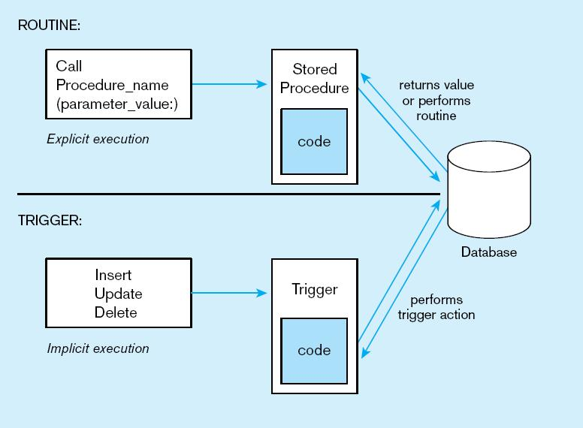
Figure7-11Triggers contrasted with stored procedures
Procedures are called explicitly
Triggers are event-driven
Source: adapted from Mullins, 1995.
Notes:
Procedures are called explicitly.
Triggers are called when a DML statement is executed

Slide 5
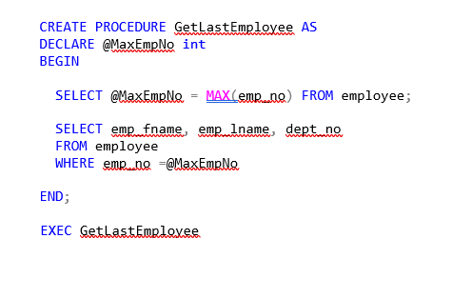
Procedure Example

Slide 6
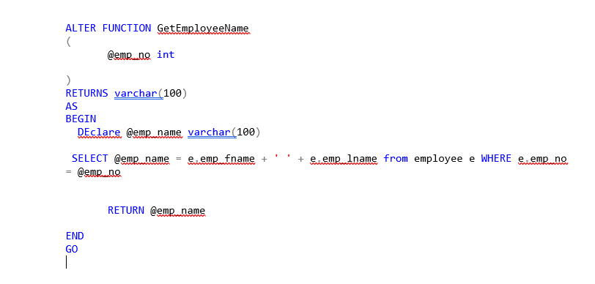
Function Example

Slide 7
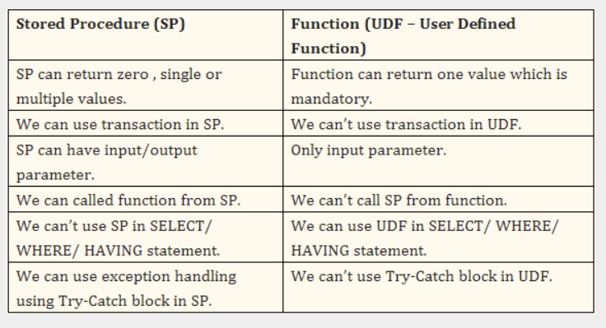
Functions v. Procedures
  https://www.codeproject.com/Questions/639495/WHY-USE-FUNCTIONS-INSTEAD-OF-STORED-PROCEDURE-IN-S

Slide 8
Types of Trigger
AFTER/BEFORE
  UPDATE
  DELETE
  INSERT
INSTEAD OF TRIGGER
  DMBS skips the DML executed.

Slide 9
Trigger Examples
Create a trigger to capture date and time when employees switch departments
Notes:
use sample
go
CREATE TABLE EmpDeptChangeHistory
(
[emp_no] int not null,
[dept_no] char(4) not null,
ChangeDt datetime
)
go
CREATE TRIGGER updEmployee ON employee
AFTER UPDATE
AS
BEGIN
IF UPDATE(dept_no)
BEGIN
INSERT INTO EmpDeptChangeHistory ([emp_no], [dept_no], ChangeDt )
SELECT [emp_no], [dept_no] , GETDATE()
FROM inserted
END
END
GO
update [dbo].[employee] set [dept_no] ='D1'
where [emp_no] = 15000
select * from EmpDeptChangeHistory

